Slide 1
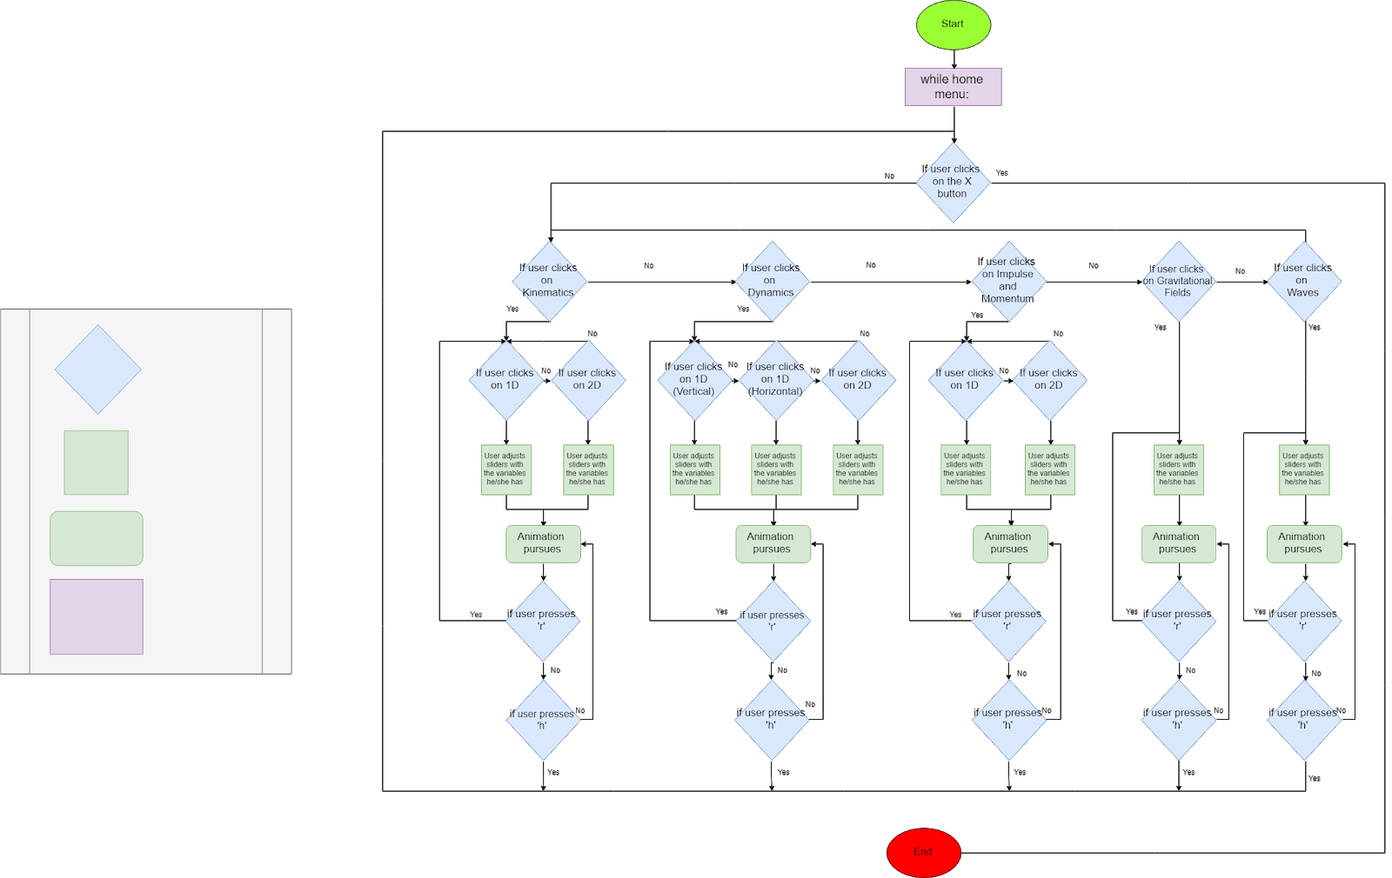
Flow Chart
If Statement
User Input
Program Display
While Loop

